Slide 1
SARS

Slide 2
For New School students, SARS simplifies the registration process so that students will be able to register without the use of advisors, because we believe that a fully independent experience will result in more efficient and effective registration.

Slide 3
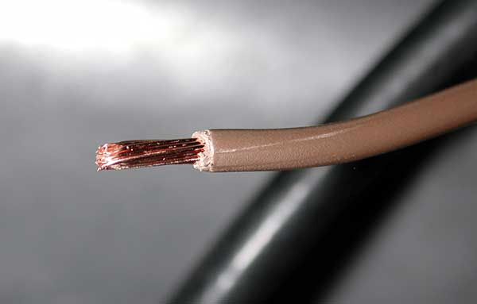

Why Registration?

Slide 4
Complaining about poor registration process

Slide 5
Complaining about poor registration process
Came up with idea during pre-registration period (topical)

Slide 6
Complaining about poor registration process
Came up with idea during pre-registration period (topical)
Frequent problem amongst classmates, in first class workshop (3 school problems)

Slide 7
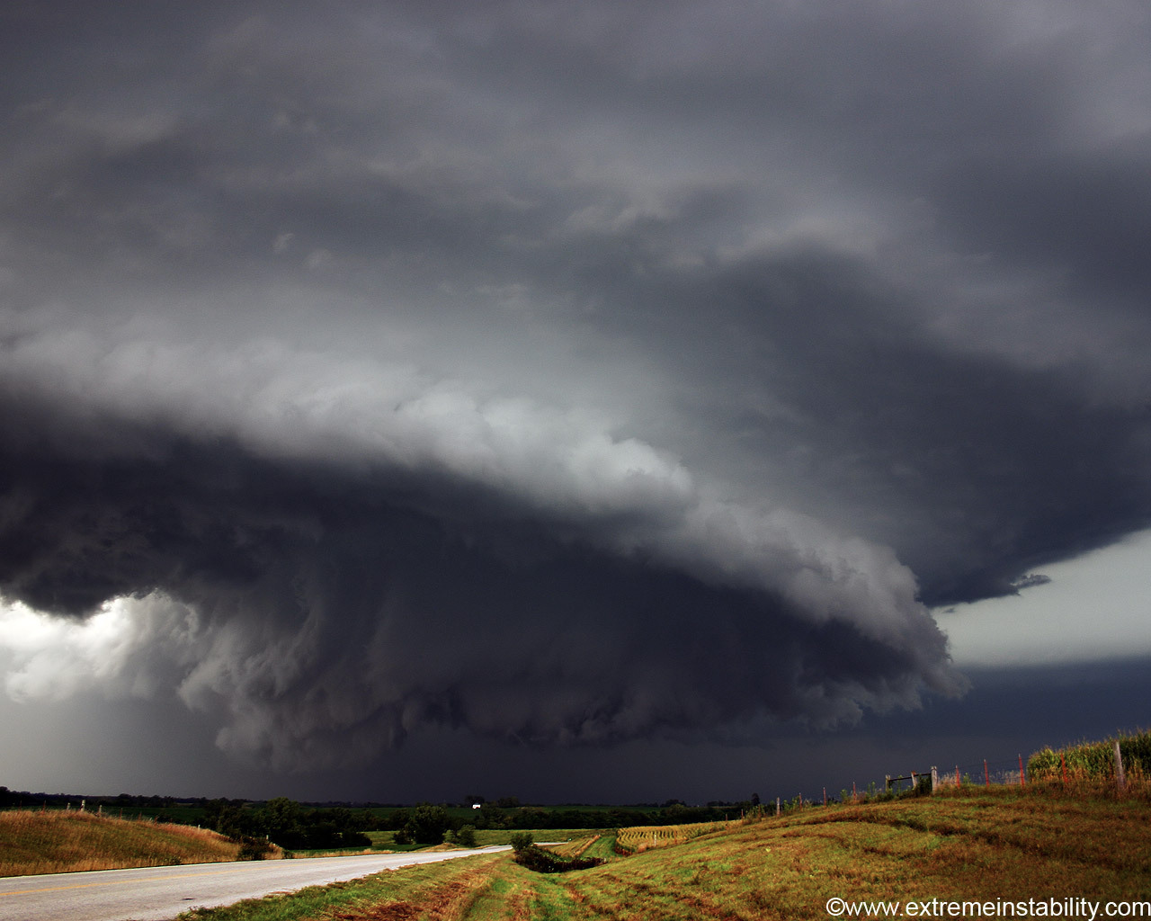


Framestorming

Slide 8
We started out with a matrix between
steps in the registration process
x
types of users
(freshman, sophomore, junior, senior)

Slide 9
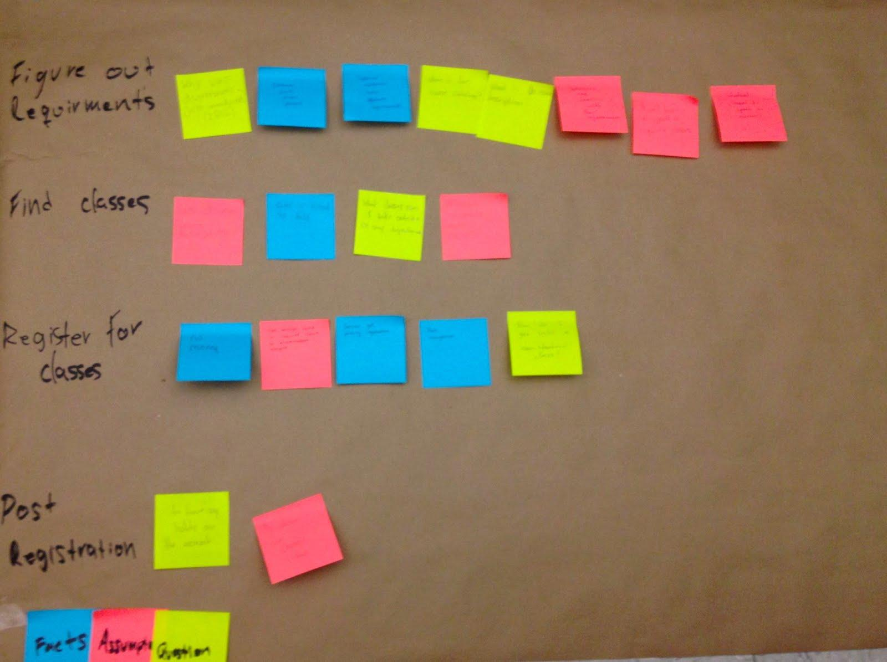
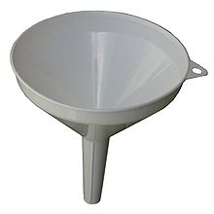
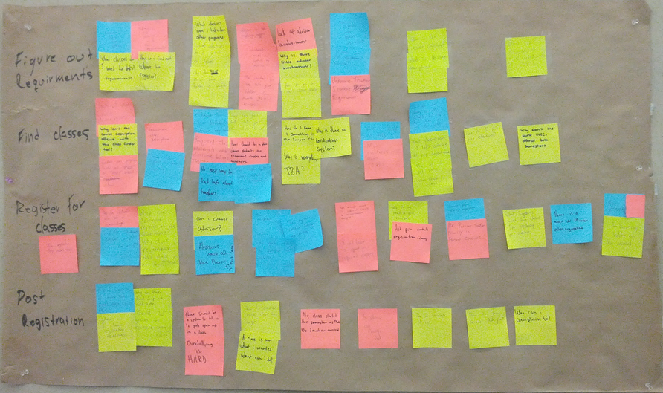

Slide 10


Identifying Users

Slide 11
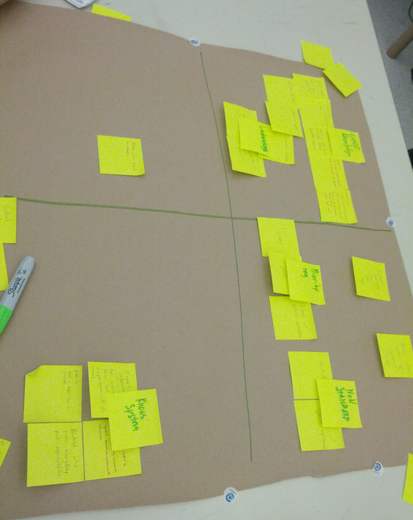

Slide 12
Ranked by importance:
Students with little knowledge.
Underdogs / disenfranchised
Non-standard students
Misc information seekers

Slide 13
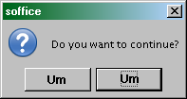
Continuums

Slide 14
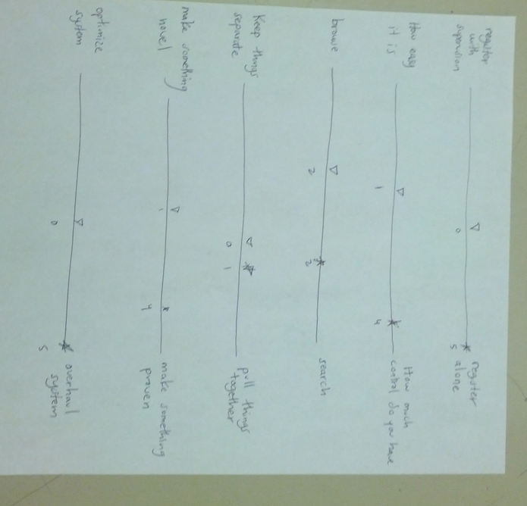
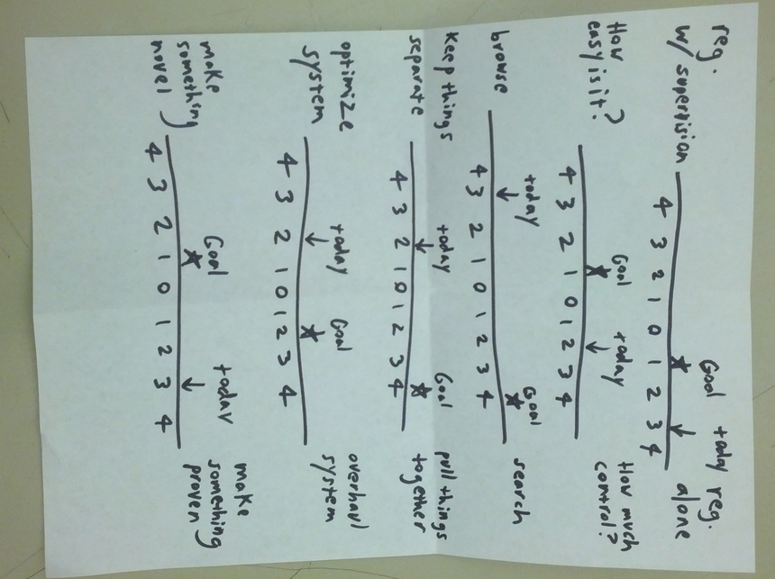
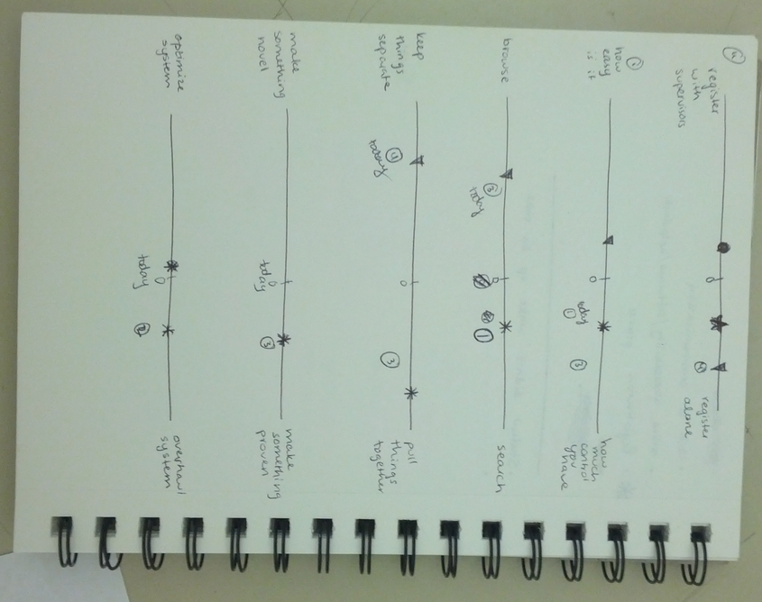
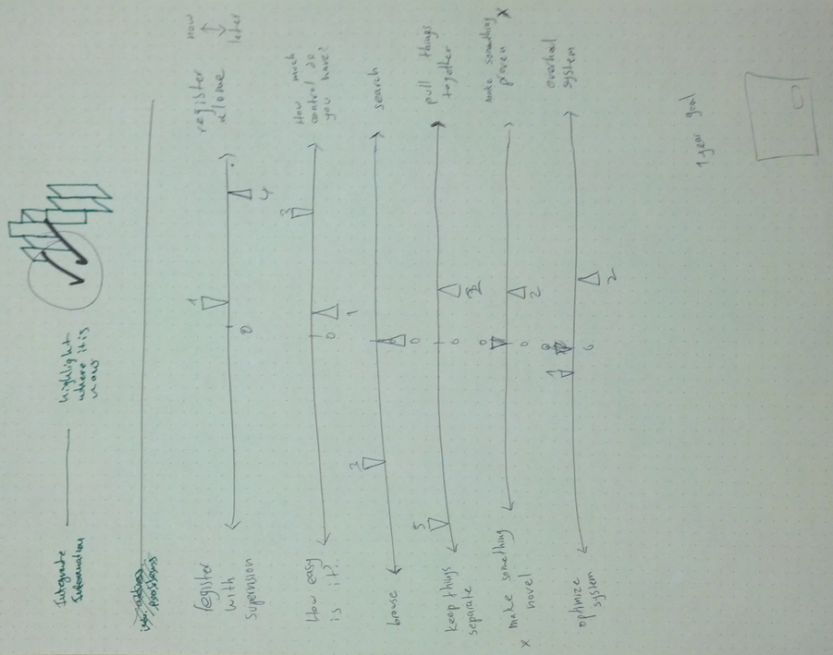
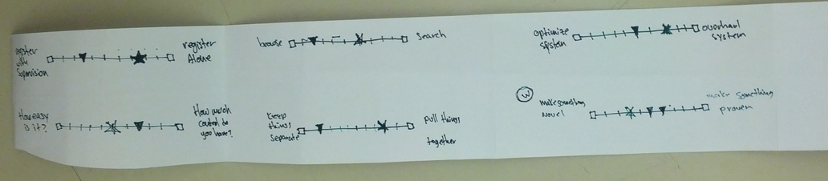

Slide 15
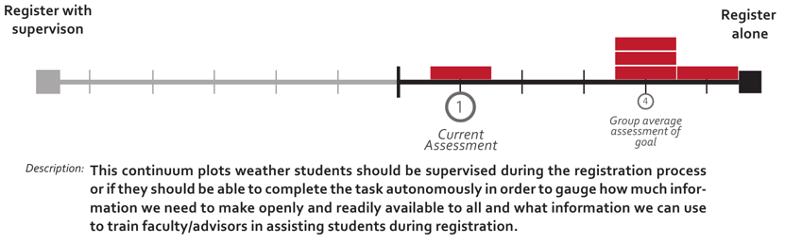
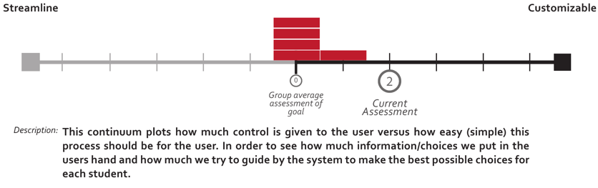
Continuums

Slide 16
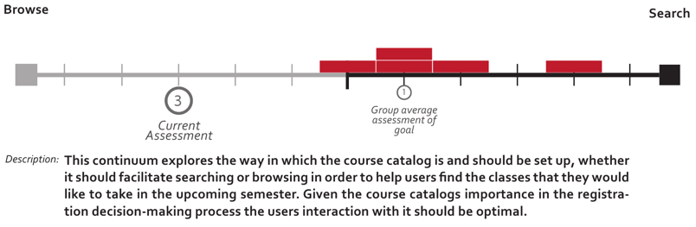
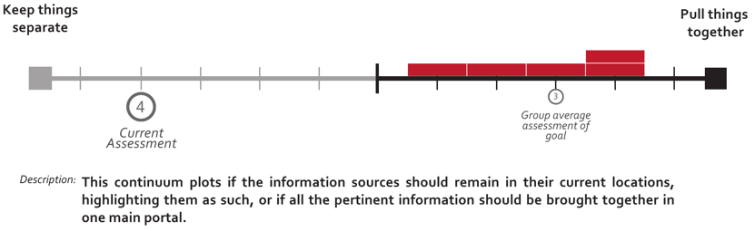

Slide 17
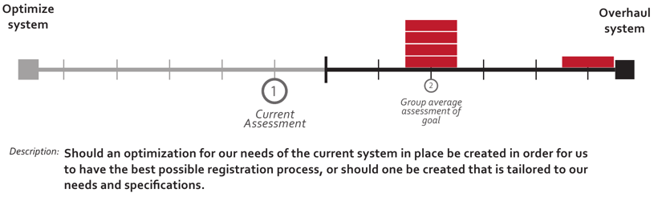

Slide 18

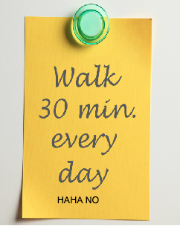
Measurable Goals

Slide 19
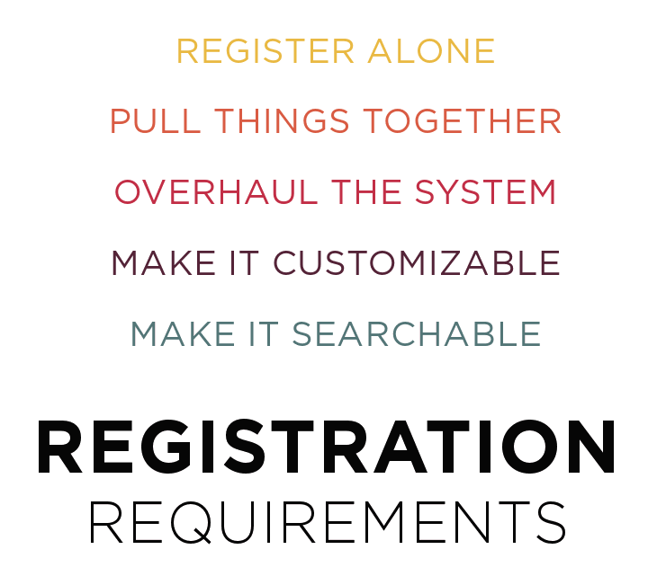

Slide 20
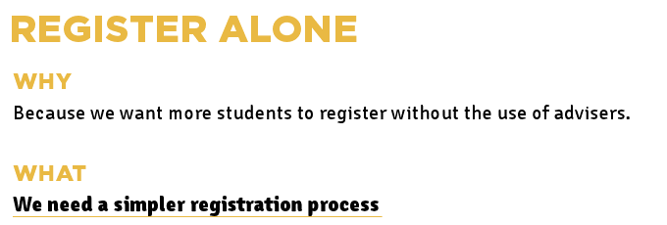
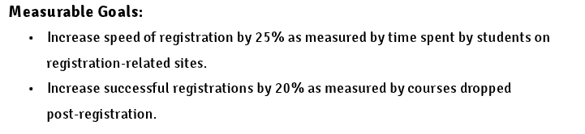

Slide 21
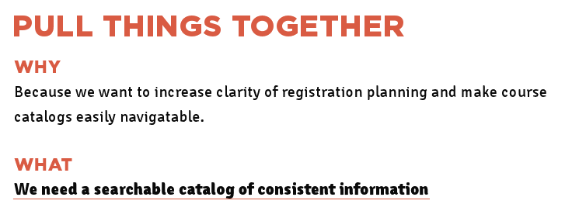
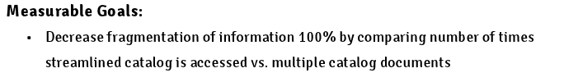

Slide 22
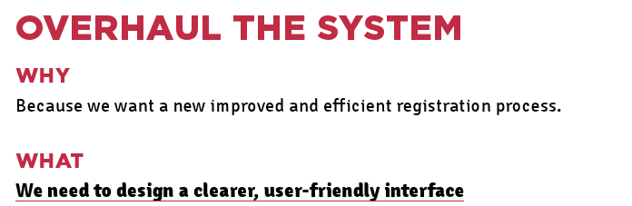
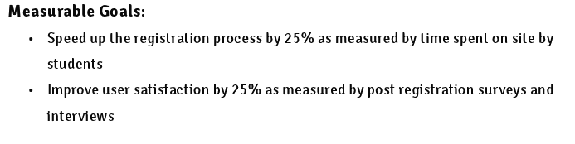

Slide 23
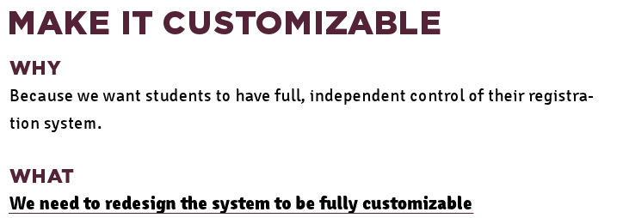
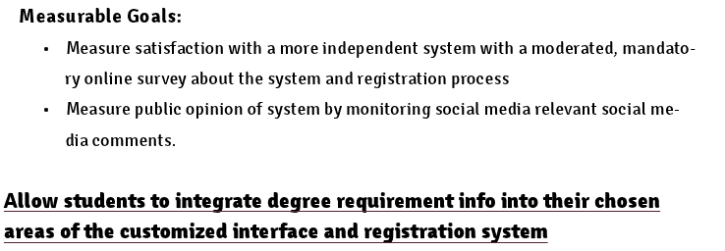

Slide 24

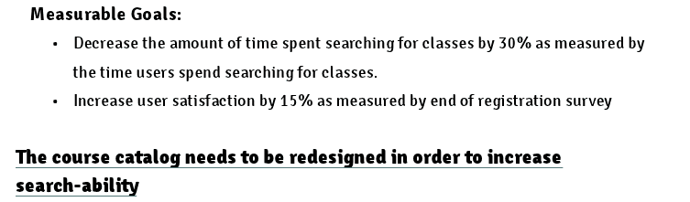

Slide 25
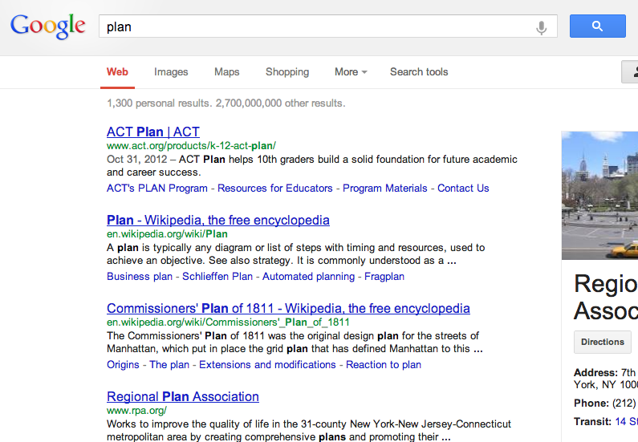
Research Plan

Slide 26
Interview students and advisors about problems with registration and prioritization of features
User test the current system (registration day, November 9)

Slide 27
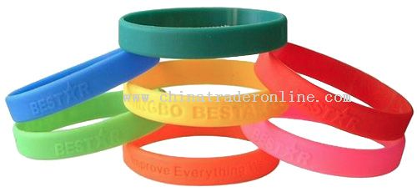

Heuristic Evaluations

Slide 28
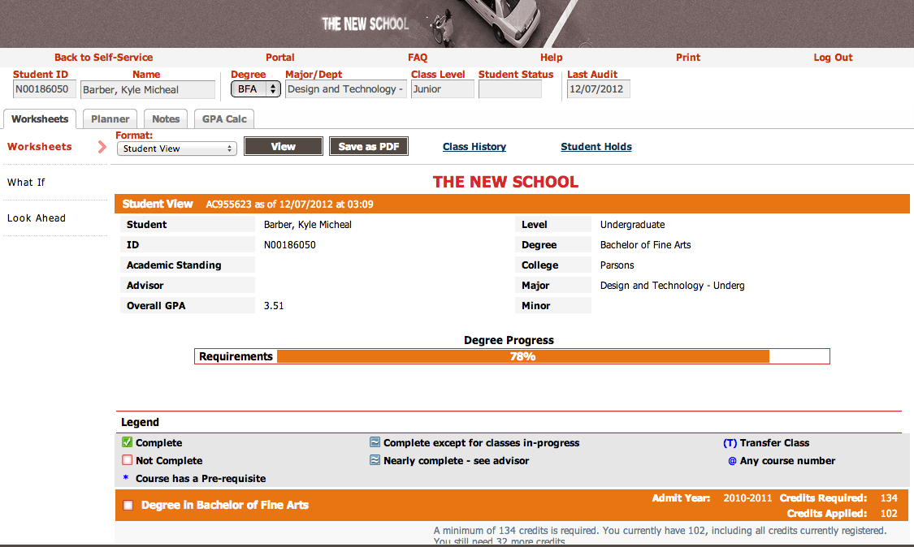
DegreeWorks

Slide 29
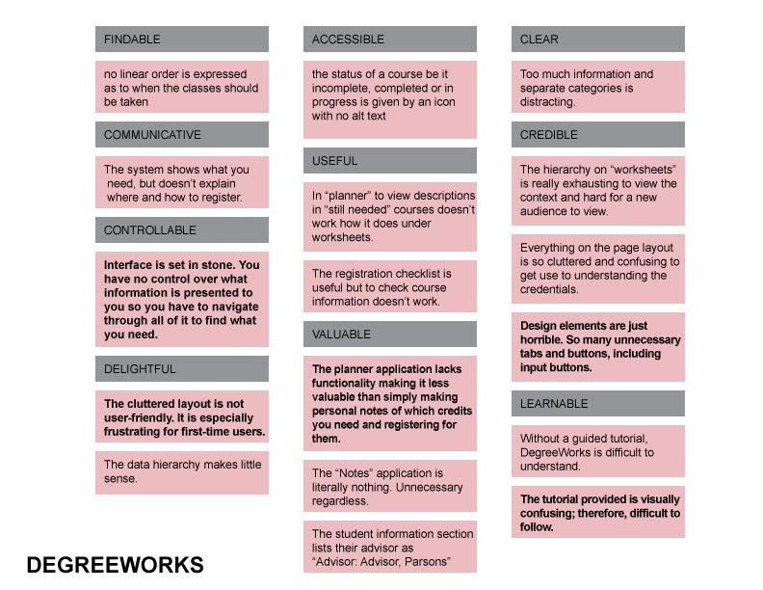

Slide 30

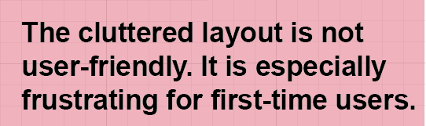

Slide 31
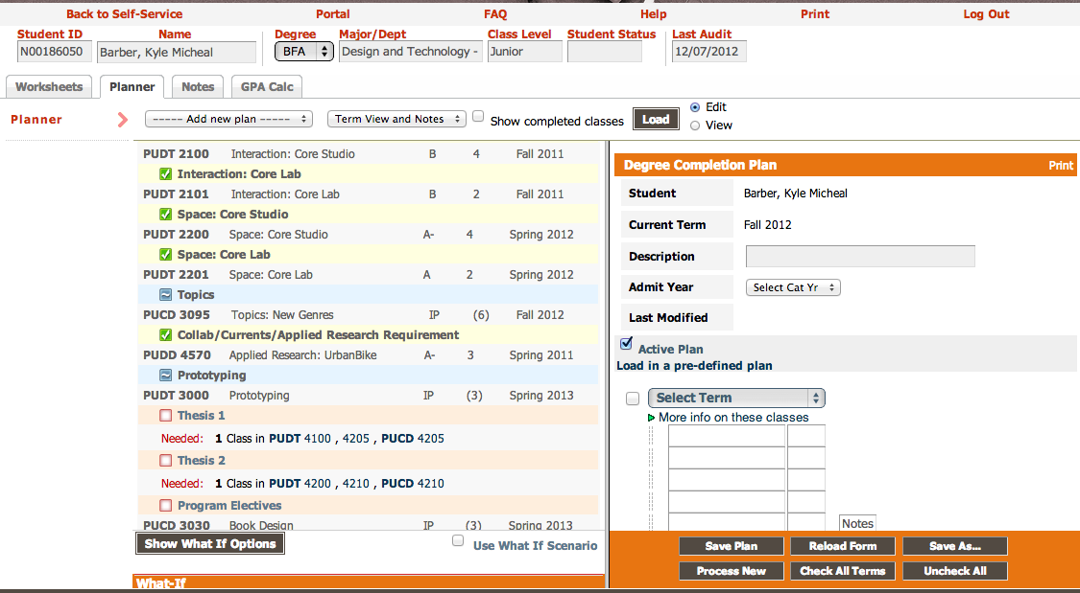
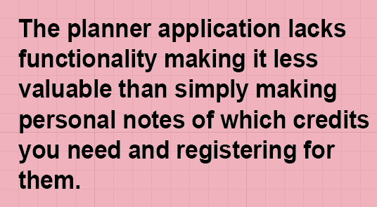

Slide 32
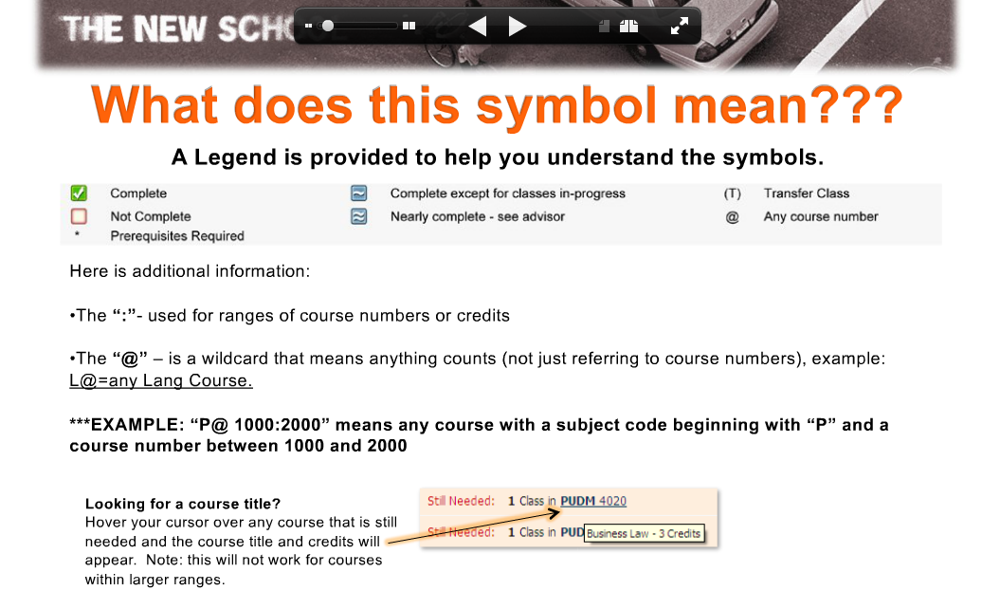
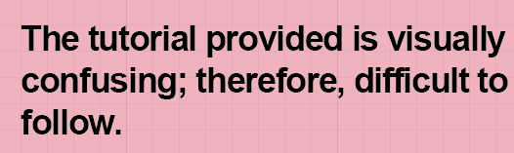

Slide 33
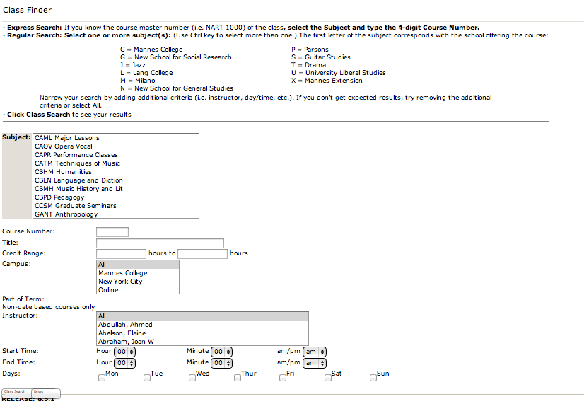
Class Finder

Slide 34
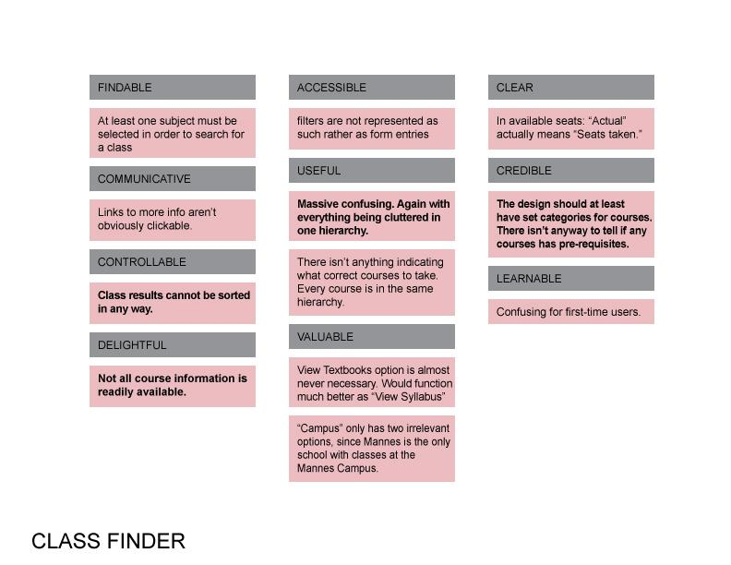

Slide 35



Slide 36
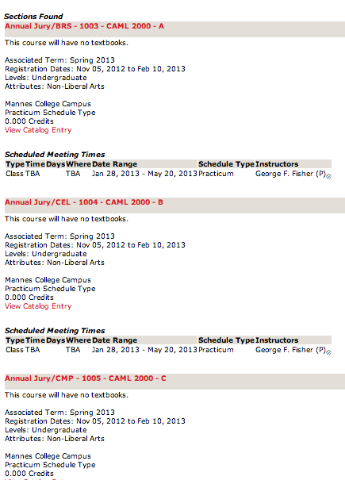
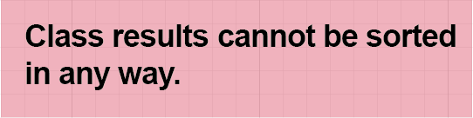

Slide 37
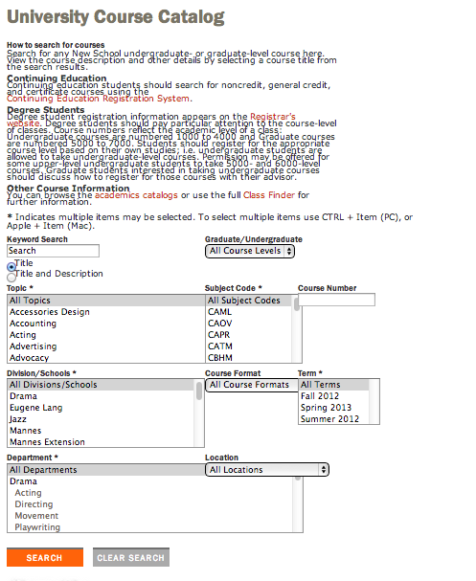
Course Catalog

Slide 38
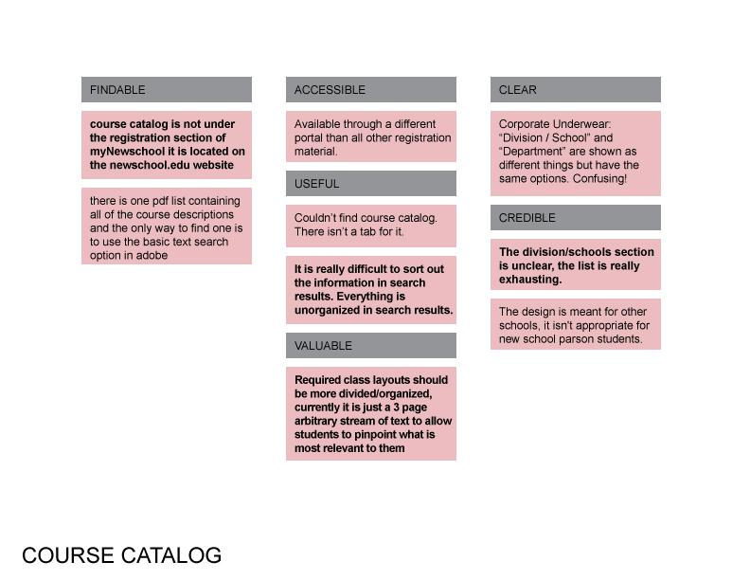

Slide 39
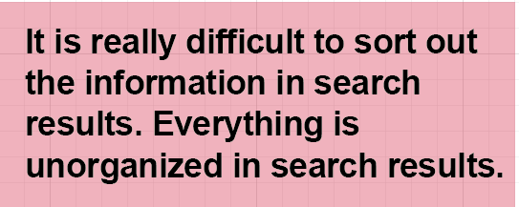
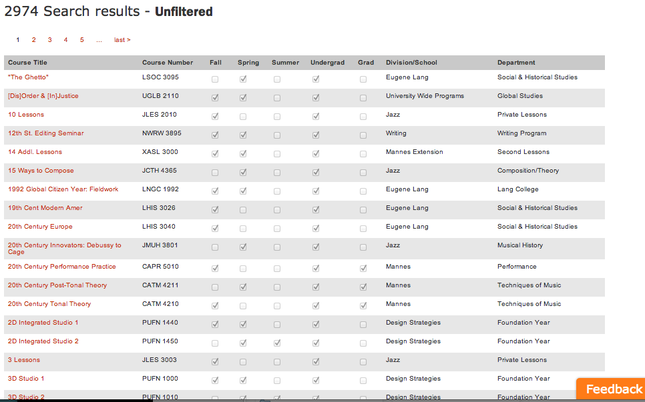

Slide 40


First Survey

Slide 41
90 people answered
Mostly multiple choice questions
Quantitative results

Slide 42
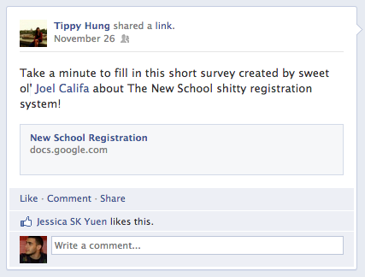
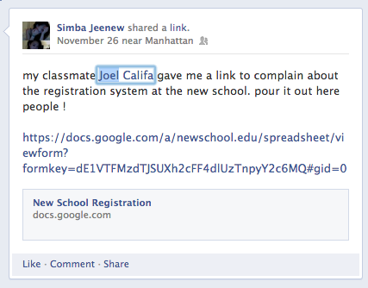
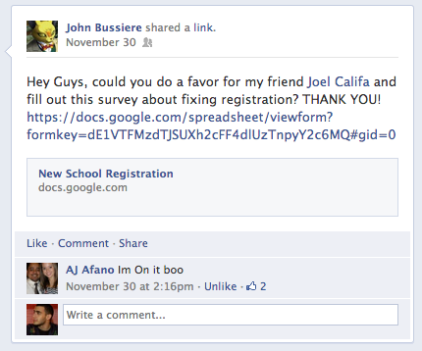

Slide 43
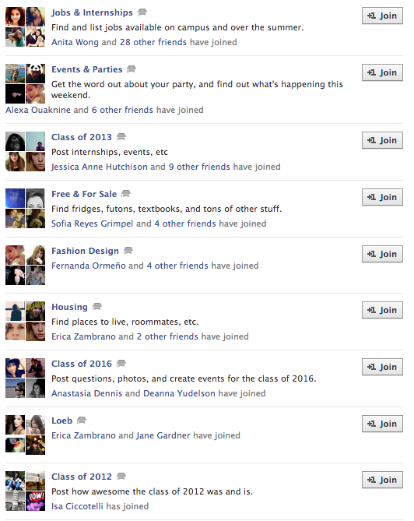

Slide 48
QUESTIONS

Slide 49
Which school within The New School do you attend
Which program are you in?
How far along are you in your degree?
Do you have any classes planned for next semester?

Slide 50
How did you find out which classes you have to take?
I feel that DegreeWorks is a helpful tool.
I feel that Class Finder is a helpful tool.
I feel that the Course Catalog is helpful

Slide 51
What do you like or dislike about the current registration process?
Have you met with your advisor regarding next semester?
I feel that my advisors are helpful
Do you have anything to add or clarify?

Slide 52
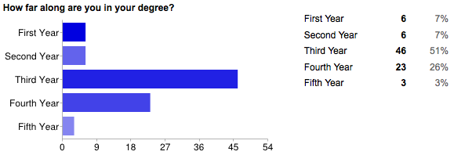

First Survey
Results

Slide 53




Slide 54
Most students appreciate the registration systems
There are still too many students that find them unhelpful, or haven't used them at all.

Slide 55




Slide 56
Slightly over half the students find their advisors unhelpful
The great majority would prefer to get their information online, instead of from advisors.

Slide 57
WHAT WE LEARNED
People find it easy to answer multiple choice questions.

Slide 58
WHAT WE LEARNED
People find it easy to answer multiple choice questions.
The questions we chose didn't tell us as much as we thought they would.

Slide 59


Second Survey

Slide 60
QUESTIONS

Slide 61
What problems did you run into, if any, when trying to figure out the requirement for next semester?
What problems did you run into, if any, when planning classes for next semester?

Slide 62
What problems did you run into, if any, on registration day?
What problems did you run into, if any, after registration day?

Slide 63
Which systems/sites did you use through the registration process? This wasn't clear, so we added some examples.
Do you feel the registration process could be better? if so, how? This wasn't clear so we added "Not just registration day, the whole process from start to finish!"

Slide 64


Slide 65


Slide 66
58 people answered
Open text questions - very informative
Qualitative results

Slide 67

X
X
Kean Ferin
X
X
X
X
X
X
X
X
X
X
X
X
X
X
X
X

Slide 68
WHAT WE LEARNED
People are much more reluctant to write open text answers.

Slide 69
WHAT WE LEARNED
People are much more reluctant to write open text answers.
People love $$$ dolla dolla bills

Slide 70
WHAT WE LEARNED
People are much more reluctant to write open text answers.
People love $$$ dolla dolla bills
Having friends from other schools (Lang, Jazz) share the survey results in a much more diverse pool.

Slide 71

Interviews

Slide 72
Kyle
BAFA
DM
Fashion
Scarlett
Associates
DT
IDC
Joel
Graduate student
CD
Maybe Jazz
Matt
Lang
Fashion
Chris
CD
CD
CD
Position
Conviction
Doubts
Color
Questions

Slide 73
STUDENTS
So we're researching how students go through the registration process
I’m going to ask you a few questions
Position
[If they answered a specific tool as where they found the classes]
Tell me about your experience using [tool] - for each tool.
What program / school are you in?
How far along are you in your degree? How do you know how far along you are?
What classes are you taking right now?
Are you satisfied with your classes?
Were you able to take all the classes you wanted to?
No
Why not?
Do you have any classes planned for next semester already?
No
How are you going to find out which classes you have to take?
Yes
Which classes?
Ask about the classes a bit. See how much they know.
Ask if a class is required, if it is:
How did you find out which classes you have to take?
What did you use to find those classes?

Slide 74
Have you met with your advisor?
No
Are you planning on meeting with them? (Why not?)
Did you meet with them last semester? (go to Yes questions)
Yes
What did you discuss / what are you planning to discuss?
How would you rate that experience? Why?
Convictions
Do you think you could have found that information out alone?
No
What do you think could help you find the information you need?
Yes
Where?
In your opinion, do you think advisors should be more or less involved?
Have you had much experience using class finder? (just “circling back to class finder” if you’ve talked about this already)
How would you rate that experience? Why?
Low: What do you think could be improved?
High: What do you like about it?
Same thing for: Degreeworks, Course Catalog
Doubts
What would make you nervous if I told you we were redesigning the registration system?
Would you prefer to get information from an advisor or have it readily available online?

Slide 75
Color
Do you have an interesting registration story?
Have you ever had a problem with the system that you feel was unique to you?
Have you used similar tools in the past? etc..
Do you feel the way things are run today should be changed? How?
Questions
Do you have anything to ask me?
ADVISORS
Position
How long have you been an advisor?
Which department do you advise for?
Which students do you advise?
What are your thoughts on the current registration process?
Convictions
FAQ’s from students
On average, how many students are seen a day?
Have you ever used the students registration system?
What systems do advisors most often use?
Have you ever had to reach out to a student?
Yes
Why did you need to contact them?

Slide 76
Advisors said there are many last minute changes and that they have limited control and limited time.
They would also like for there to be a good online information resources for students, though they mentioned the registration tutorial.

Slide 77


Making Maps

Slide 78


Slide 79


Slide 80


Slide 81


Slide 82


Slide 83
 | Figure Out Requirements | Find Classes | Register for Classes | Post Registration
DegreeWorks
Class Finder / Course Catalog
Registration
Other / Advisors

Slide 84
 | Figure Out Requirements | Find Classes | Register for Classes | Post Registration
DegreeWorks
Class Finder / Course Catalog
Registration
Other / Advisors

Slide 85





Slide 86


Slide 87


Slide 88


Slide 89


Slide 93
BIG ISSUES #1
Students need to open many different windows to get the information they want.
Students find the current timing of registration unfair and stressful.

Slide 94
BIG ISSUES #2
Students are too dependent on advisors for over-tallying and other needs, as advisors are often unresponsive or unhelpful.
Many students are unaware of DegreeWorks or unsure how to use it.

Slide 95
BIG ISSUES #3
Students want class information displayed at a glance, for more efficient registration.
Classes do not indicate whether students can or cannot register for them, and this often comes up during registration day.

Slide 96

New Direction

Slide 97
WHAT WE LEARNED
Goals may change as research develops. Advisors to Integration
We learned a lesson: Conduct thorough research from the start
Do not jump immediately to solutions. Frame the problem.

Slide 98
ONE REGISTRATION
Integration makes you beautiful

Slide 99
We got 99 slides but a pitch ain't one. It's two.
For New School students, One Registration simplifies registration by integrating the separate systems, because we believe a single registration hub will solve issues of awareness, clarity, and advisor dependency.

Slide 100

Roadmap

Slide 101
We decided to overhaul the system

Slide 102
We shouldn't be fixing the current systems, we should be creating a new one that fixes the issues we found.

Slide 103
By Spring 2014, we should release a beta of the single new registration system that replaces the current system(s) and fixes the issues found.
This new system should be able to handle heavier traffic, at which point registration timing should be changed.

Slide 104
fin.

